Slide 1
Privacy Preserving Ads

Slide 2
Agenda
Quick Recap of PARAKEET
MaCAW
Test setup update for PARAKEET

Slide 3



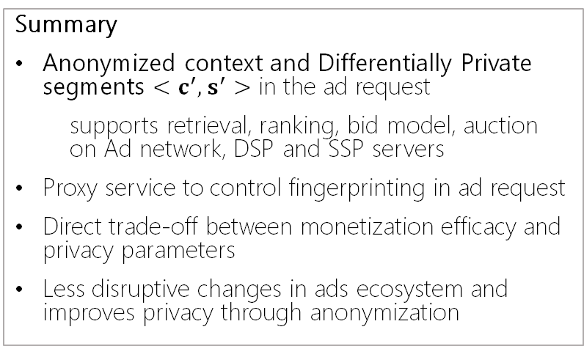

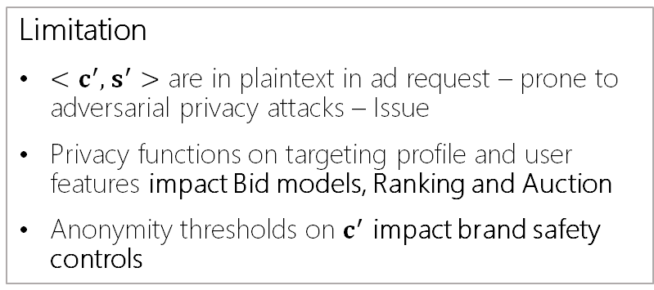
PARAKEET Private and Anonymized Requests for Ads that Keep Ad Efficiency and Enhance Transparency
Summary
Anonymized context and Differentially Private segments $<c^{′},s^{′}>$ in the ad request
supports retrieval, ranking, bid model, auction on Ad network, DSP and SSP servers
Proxy service to control fingerprinting in ad request
Direct trade-off between monetization efficacy and privacy parameters
Less disruptive changes in ads ecosystem and improves privacy through anonymization
BROWSER
PUBLISHER
4
AD
SSP/
DSP
7
Winner Ad
Anon Request
Request
Anonymization
+
Proxy
AdReq(C’, S’)
$$F$$
6
5
U
AdReq(C), S’
Ad
Retrieval
Ranking & Pricing
Budget Control
Limitation
$<c^{′},s^{′}>$ are in plaintext in ad request – prone to adversarial privacy attacks – Issue
Privacy functions on targeting profile and user features impact Bid models, Ranking and Auction
Anonymity thresholds on $c^{′}$ impact brand safety controls
Browser User Segment and feature Storage
Privacy Analysis & Targeting Anonymization
DSP
Ad Xchange
U
S’
3
$$β$$
U
s1
s2
sn
{s1, s2}
2
{s1, s2, …}
1
ADVERTISER 123
JS
LEGEND:
C – publisher context
C’– anonymized publisher context - link scrubbing, keywords and category scrubbing
S’– differentially private user targeting and features

Slide 4





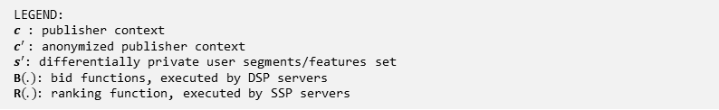
PARAKEET simplified
BROWSER
PUBLISHER
AD
BROWSER SERVICE
Ad Servers
4
Ad
Anonymization & Proxy
SSP+DSP
2
3
3.1 Retrieve candidate ads using $c^{′},s^{′}$
3.2 DSP: Compute bids B(.) and selects creatives
3.3 SSP: executes ad Quality controls, auction R(.) and provide winning ad
AdReq(c), s’
$$\left(c^{′},s^{′}\right)$$
Ad Set A
Control
Browser Targeting Storage
s’
$$s_{0}$$
$$s_{1}$$
$$s_{n}$$
1
$$<s_{1}, s_{2}>$$
ADVERTISER
JS
LEGEND:
$c$ : publisher context
$c^{′}$: anonymized publisher context
$s^{′}$: differentially private user segments/features set
B$(.)$: bid functions, executed by DSP servers
R$(.)$: ranking function, executed by SSP servers

Slide 5



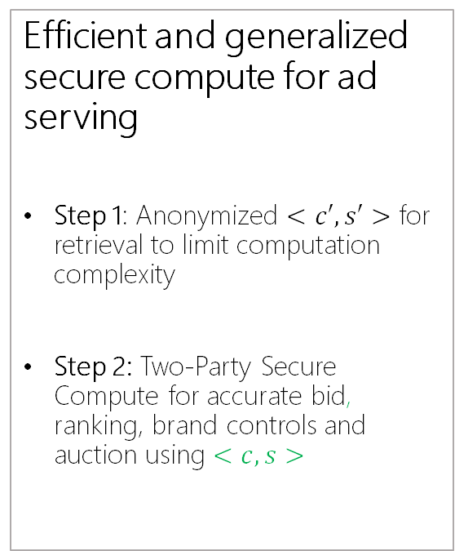







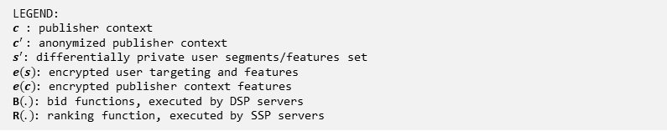

MaCAW – Multi-party Computation of Ads on the Web
BROWSER
Efficient and generalized secure compute for ad serving
Step 1: Anonymized $<c′,s′>$ for retrieval to limit computation complexity
Step 2: Two-Party Secure Compute for accurate bid, ranking, brand controls and auction using $<c,s>$
PUBLISHER
AD
BROWSER SERVICE
Ad Servers
2
Anonymization & Proxy
3
SSP+DSP
AdReq(c), s’
$$\left(c^{′},s^{′}\right)$$
Ad Set A
3.1 Retrieve candidate ads using $c′,s′$
Secure Compute
2-party SC for bid, advertiser checks
4
DSP
7
Ad
Encrypt $c, s$
Decrypt B(.)
Filter ads with 0 bid
$${(e\left(c\right), e\left(s\right), a}_{i}) for ∀a_{i}∈A$$
$B(.)$
4.1 Evaluate $1\left(e\left(c\right)\right)∗B(e\left(c\right), e\left(s\right),a_{i})$
4.2 Compress and share partial values
Control
Browser Targeting Storage
5
SSP
Encrypt $a_{i}, b_{i}$
Decrypt R(.)
Identify ad w/ max R(.)
$({c, e(a}_{i}), e(b_{i}))$
$R(.)$
5.1 Evaluate $R(c, e\left(a_{i}\right),{e(b}_{i}))$
5.2 Compress and share partial values
s’
6
$$s_{0}$$
$$s_{1}$$
$$s_{n}$$
2-party SC for auction, publisher control
1
$$<s_{1}, s_{2}>$$
ADVERTISER
JS
LEGEND:
$c$ : publisher context
$c^{′}$: anonymized publisher context
$s^{′}$: differentially private user segments/features set
$e(s)$: encrypted user targeting and features
$e(c)$: encrypted publisher context features
B$(.)$: bid functions, executed by DSP servers
R$(.)$: ranking function, executed by SSP servers
Notes:
CrypTFlow2: Practical 2-Party Secure Inference
Rathee, Deevashwer and Rathee, Mayank and Kumar, Nishant and Chandran, Nishanth and Gupta, Divya and Rastogi, Aseem and Sharma, Rahul
CCS '20: Proceedings of the 2020 ACM SIGSAC Conference on Computer and Communications Security
https://www.microsoft.com/en-us/research/project/ezpc-easy-secure-multi-party-computation/

Slide 6
Ad Response
const adResponse = {
'ads': [{
creative-id: 'hashid'
creative: 'https://ad-creative.cdn',
bid-inference-origin: 'https://dsp.example',
bid-model-format: 'https://dsp.example/bidmodel-structure-for-service.out',
contextual-signal-processor: 'https://dsp.example/feature-processing.js'
fallback-bid: 1.00,
lang: 'en-us',
adtype: 'image/native'
},
],
auction-inference-origin: 'https://ssp.ad-network.example',
auction-model-format: 'https://dsp.example/rankingmodel-structure-for-service.out',
fallback-ranking: 'highest-bid'
ad-signal-processor: 'https://ssp.example/feature-processing.js'
ranking-signals: ['coarse-geolocation', 'coarse-ua', 'encrypted-ad', 'encrypted-bid']
}

Slide 7
Working with 2 party secure compute
Browser Service
Ad Server
Leverage EzPC complier for generic code
model.out
model.out
model.weights
Compiler
python path/to/EzPC/Athos/CompileTFGraph.py --config config.json --role server/client
"model_name": "model.pb
Training process
model.pb
Ad Server model training

Slide 8
Key Considerations
Performance and Comm requirements for 2PC
N | Time (ms) | Total Comm (MiB) | Peak Mem Server (MiB) | Peak Mem Client (MiB)
400 | 201 | 51.46 | 65.73 | 50.89
1600 | 2585 | 804.73 | 693.43 | 378.01
3200 | 9913 | 3215.76 | 2654.21 | 1365.53
Improvements
Mixed mode computation – random subset of variables are encrypted
3PC – non-colluding helper party to support secure compute
N | Time (ms) | Client Total Comm (MiB) | Server Total Comm (MiB) | Helper Total Comm (MiB) | Peak Mem Client (MiB) | Peak Mem Server (MiB) | Peak Mem Helper (MiB)
400 | 13 | 2.44 | 2.45 | 0.003 | 17.39 | 17.44 | 17.46
1600 | 677 | 39.08 | 39.09 | 0.012 | 148.38 | 148.02 | 128.84
3200 | 1661 | 156.29 | 156.32 | 0.024 | 558.01 | 558.57 | 482.54

Slide 9
PARAKEET test setup

Slide 10
PARAKEET test setup
Polyfill library for ad interests, ad request and rendering
Request:
Participants for alpha trials
Dev setup
Advertiser.com JS changes to leverage polyfill library to handle user features
Ad Request changes to access user features
Ad server changes to accept user features in request (instead of cookie), and enable ad serving
Goal:
Implement ad serving flows – user features in browser and runtime read access
Provide robust ad parameter setup – placement size, location, device etc.
Data flows and key management for user feature encryption/decryption

Slide 11
Next Steps
Post your questions or issues via GitHub repo
We’ll provide regular updates on progress on development, test and design
Participate in the design discussions in bi-weekly calls

Slide 12
Discussion

